Slide 1



Unlocking Insights: Audits & Analytics
The Power of Data
May 21, 2025

Slide 2

Housekeeping Items
Before We Get Started
A recording of this webinar will be sent to you after today’s presentation.

Slide 3



Housekeeping Items
Before We Get Started
All attendees will be placed on mute.
Please place questions in the chat tab.
A survey will be sent out after the webinar.

Slide 4



Housekeeping Items
Before We Get Started:
If you’re having trouble with audio or viewing the webinar, please:
Try refreshing your browser.
Try a different browser.
Ask for assistance in the chat tab.

Slide 5


Meet Your Presenters
Amy Miller
Ellen Kopel
VP of Training
PNI•HCM
Consultant Manager
PNI•HCM
Notes:
Disclaimer on Tax Advisors / Legal Counsel;
Educational Purposes (things change)

Slide 6

Agenda
What’s New?
Reviewing Analytical Reports
Exporting Screens
Discover Non-Conventional Reporting
Introduce Predictive People Analytics
Notes:
Sam
Does my state require me to offer a retirement plan?
The employees that have been with me for a while- do they have a way to save?
Do I know how muh I will be incentivized to setup a new 401(k) plan? Do I know how to use my plan as a tax shelter with my existing one?
The employees who

Slide 7
What are the advantages of analytical reports?
Polling Question
*Polls will appear above the chat window.
Notes:
Better Decision Making
Efficiency – Improved Productivity
Cost Savings
Predictive Insights
(all of the above)

Slide 8

The High Cost of Guesswork
Financial Loss
Companies lose $1M yearly per 1000 employees due to poor data quality.
Data Access
Only 44% of executives have the talent data they need.
Analytics Advantage
Using workforce analytics increases likelihood of effective talent pipelines by 82%.
Notes:
Better Decision Making
Efficiency – Improved Productivity
Cost Savings
Predictive Insights
(all of the above)

Slide 9

EEO Compliance: Beyond the Numbers
Compliance Costs
Workplace Reality
Analytics Use
Violations cost $50,000 to $100,000 per incident.
41% of employees have witnessed or experienced discrimination (2023).
Run EEO reports to monitor hiring, promotion, and pay equity.
Notes:
Improved EEO compliance scores by 20% through audits

Slide 10





Actionable Insights: From Data to Strategy
Identify Issues
Root causes of dissatisfaction.
Retention Plans
Targeted strategies.
Optimize Pay
Compensation and benefits.
Diversity Drive
Inclusion initiatives.

Slide 11



Exploring the Power of Analytics
Saving You Money
Saving You Time
Supporting the Planning Needs of Your Business
Notes:
Amy
In a study completed by SHRM – 57% reported that people analytics has produced profits and savings for their organization.
In fact, with HR leaders – 40% have shared they are looking to invest in HR Analytics this year along.

Slide 12
Reporting Needs You Didn’t Know You Needed
KPIs
Organizational Charts
EEO / Demographic
Headcount / Turnover
Predictive Reports
Notes:
The current state of retirement plan legislation in the US is significantly influenced by the SECURE 2.0 Act. This map below highlights U.S. states that have introduced retirement savings programs. As we know, these are designed to help private sector employees who are without access to a workplace retirement plan save for their future.
Program mandates, structure, and roll-outs vary state by state, so it's essential to understand how these developments may apply to you. Click on your state from the map below to learn about the developments for a retirement program, possible mandates, and timelines as of March 12, 2025.
In yellow – legislation is introduced
Blu – legislations has passed ad programs have launched.
Pink - legislation passed and the launch is being determined
Gray and just 2 – no legislation passed – SD and AL

Slide 13

Let’s Explore
Notes:
Are you, or do you have a third party uploading retirement reports between payroll and your retirement platform when you process payroll?
How many questions per week do you receive from employees regarding their retirement plan?
Do you have a “go-to” contact for questions you’re not sure about?
Who is filing your 5500 form per year?
Raise your hand if you would rather have someone else to hand this off to, that you know is proficient in retirement plans, and will guide your employees to the correct answer they’re looking for?

Slide 14
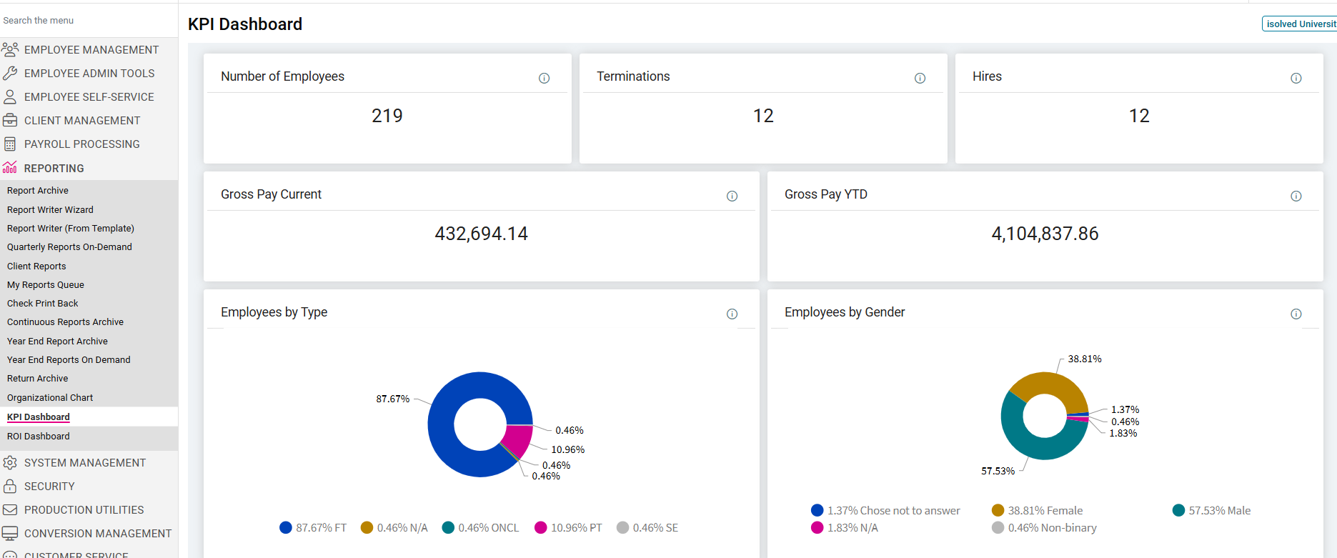
KPI's, Org Charts, and ROI – Our Newest Features
Notes:
There is even more on these dashboard like - Headcount by Tenure, Headcount Trend by Generation (Baby Boomers, Millenials, etc), and Hires vs. Terminations, and Hiring Trends by Location.

Slide 15
Polling Question
Do you know what Predictive People Analytics is?
*Polls will appear above the chat window.

Slide 16

Actionable insights to support more strategic decision making.
Notes:
A lack of access to important people data leads to ineffective decision-making. Even with this data, organizations can face challenges allocating sufficient time and resources to analyze it effectively. As a result, data-driven decision-making suffers, impacting business outcomes and the employee experience.
With isolved Predictive People Analytics, you gain access to enterprise-grade analytics and actionable insights from data across the entire isolved People Cloud™ platform. Intuitive and configurable dashboards mean you can easily view key people metrics and make informed decisions with no data analysis expertise required

Slide 17
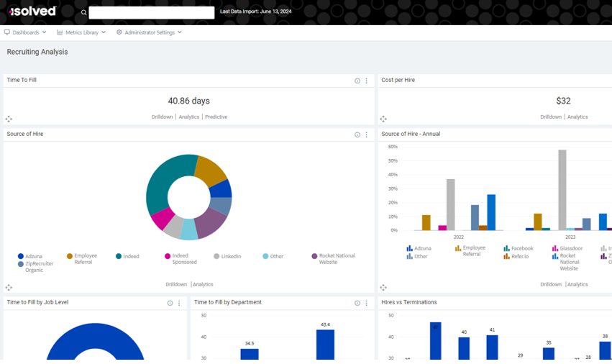
Analytic Dashboards: Configure key people metrics on dashboards.
Notes:
Generate trend reports using historical metrics and identify correlations with key events
Configure visually intuitive dashboards to view key people metrics in a centralized or segmented way
Set targets using Predictive Guidance and receive recommendations to achieve those outcomes • Use Benchmark Insights to compare industry averages to internal positions

Slide 18
Thank you for joining us today!
Any questions?

Slide 19
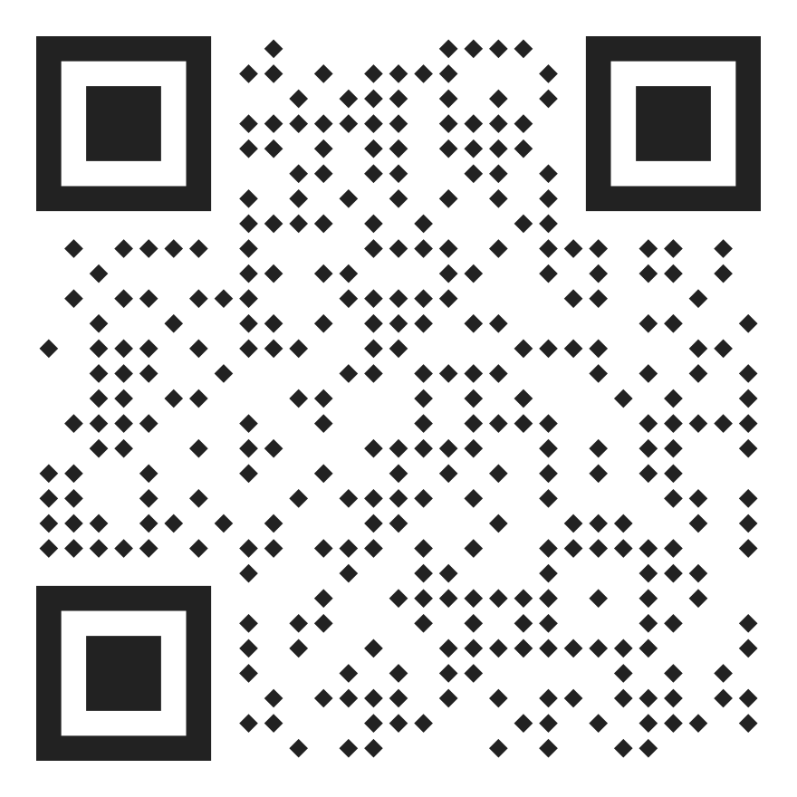
The Training Trifecta:
Skills, Software & State Compliance
Join Us Next Month!
Scan to Register
June 25, 2025

